Slide 1
Lecture 9 Relational Database Design Functional Dependencies
Good Design
Atomic
Dependencies
BCNF
3rdNF
MVDs
Design Process
United International College

Slide 2
Outline
Good Design
Atomic
Dependencies
BCNF
3rdNF
MVDs
Design Process
Features of Good Relational Design
Atomic Domains and First Normal Form
Functional Dependency Theory
BCNF
3rd Normal Form
Multivalued Dependencies and Decomposition
Database-Design Process

Slide 3
Functional Dependencies
Good Design
Atomic
Dependencies
BCNF
3rdNF
MVDs
Design Process
Functional dependencies are some constraints on the set of legal relations.
The constraint is that the value for a certain set of attributes uniquely determines the value for another set of attributes.
A functional dependency is a generalization of the notion of a key.

Slide 4
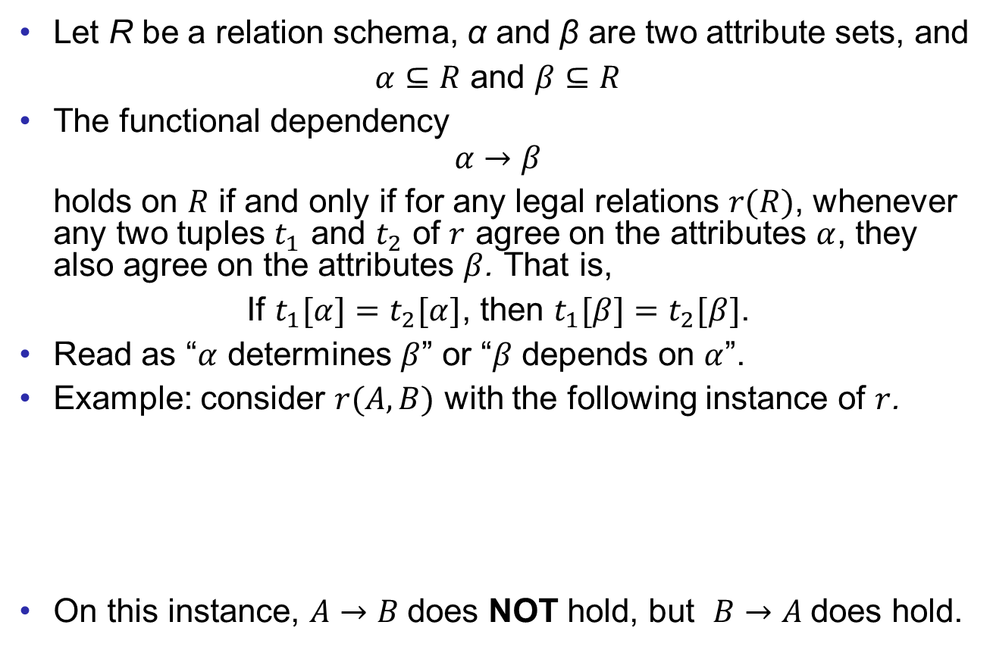
Functional Dependencies - Definition
Good Design
Atomic
Dependencies
BCNF
3rdNF
MVDs
Design Process
Let R be a relation schema, α and β are two attribute sets, and
$α⊆R$ and $β⊆R$
The functional dependency
$$α→β$$
holds on $R$ if and only if for any legal relations $r(R)$, whenever any two tuples $t_{1}$ and $t_{2}$ of $r$ agree on the attributes $α$, they also agree on the attributes $β$. That is,
If $t_{1}[α]=t_{2}[α]$, then $t_{1}[β]=t_{2}[β]$.
Read as “$α$ determines $β$” or “$β$ depends on $α$”.
Example: consider $r(A,B)$ with the following instance of $r$.
On this instance, $A→B$does NOT hold, but $B→A$does hold.
A | B
1 | 4
1 | 5
3 | 7

Slide 5
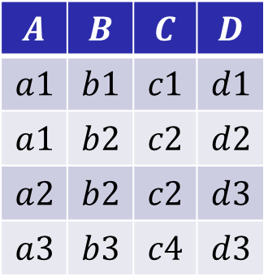

Example
Good Design
Atomic
Dependencies
BCNF
3rdNF
MVDs
Design Process
Which FDs may exist in this relation $R(A,B,C,D)$?
$B→C$, $C→B$
$AB→C$
The combination of any two attributes (except $BC$) determines others.
$$A$$ | $$B$$ | $$C$$ | $$D$$
$$a1$$ | $$b1$$ | $$c1$$ | $$d1$$
$$a1$$ | $$b2$$ | $$c2$$ | $$d2$$
$$a2$$ | $$b2$$ | $$c2$$ | $$d3$$
$$a3$$ | $$b3$$ | $$c4$$ | $$d3$$

Slide 6
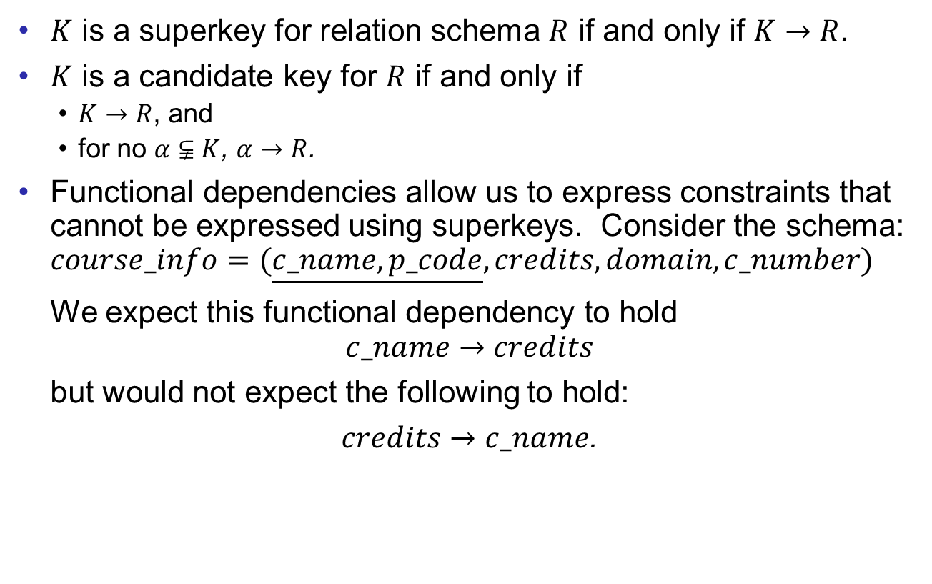
Functional Dependencies - Properties
Good Design
Atomic
Dependencies
BCNF
3rdNF
MVDs
Design Process
$K$ is a superkey for relation schema $R$ if and only if $K→R$.
$K$ is a candidate key for $R$ if and only if
$K→R$, and
for no $α⫋K$, $α→R$.
Functional dependencies allow us to express constraints that cannot be expressed using superkeys. Consider the schema:
$$course_info=(\underline{c_name,p_code},credits,domain,c_number)$$
We expect this functional dependency to hold
$$c_name→credits$$
but would not expect the following to hold:
$credits→c_name$.

Slide 7

Use of Functional Dependencies
Good Design
Atomic
Dependencies
BCNF
3rdNF
MVDs
Design Process
We use functional dependencies to:
test relations to see if they are legal under a given set of functional dependencies.
If a relation $r$ is legal under a set $F$ of functional dependencies, we say that $r$ satisfies $F$.
specify constraints on the set of legal relations
We say that $F$ holds on the schema $R$ if all legal relations on $R$ satisfy the set of functional dependencies $F$.

Slide 8
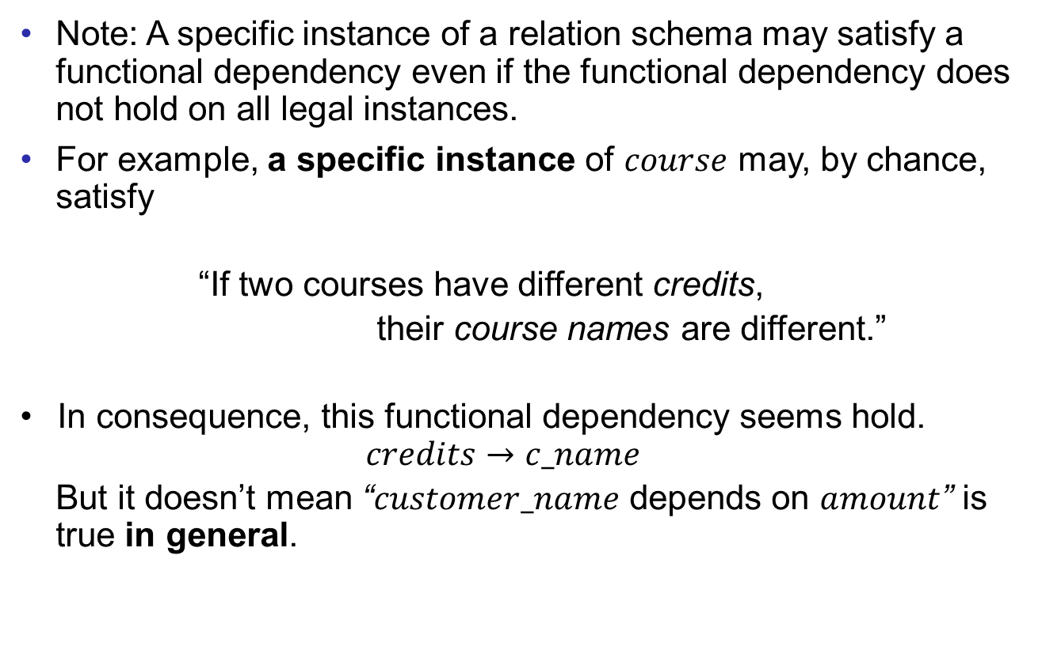
Use of Functional Dependencies
Good Design
Atomic
Dependencies
BCNF
3rdNF
MVDs
Design Process
Note: A specific instance of a relation schema may satisfy a functional dependency even if the functional dependency does not hold on all legal instances.
For example, a specific instance of $course$ may, by chance, satisfy
“If two courses have different credits,
their course names are different.”
In consequence, this functional dependency seems hold.
$$credits→c_name$$
But it doesn’t mean “$customer_name$ depends on $amount$” is true in general.

Slide 9
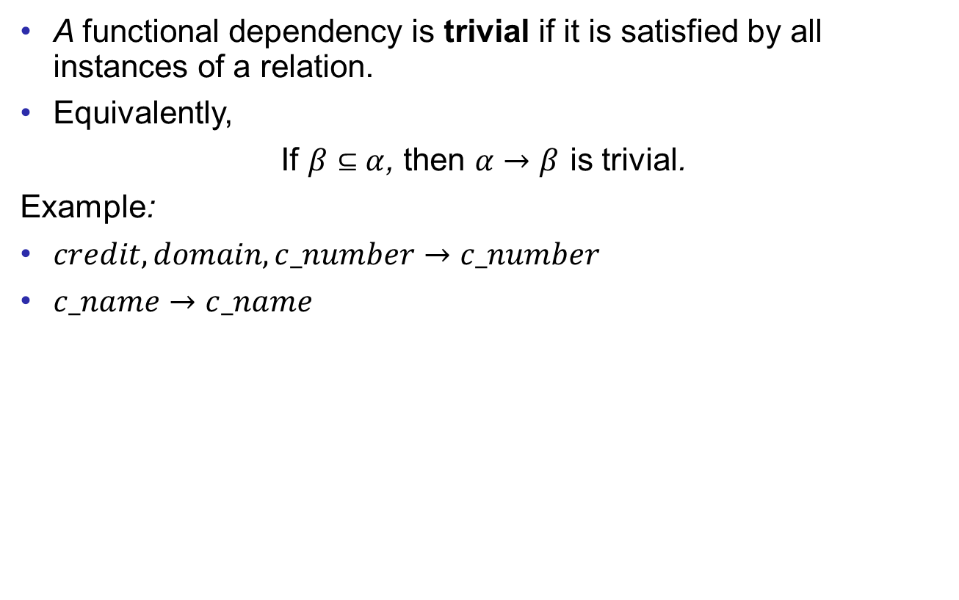
Functional Dependencies (Cont.)
Good Design
Atomic
Dependencies
BCNF
3rdNF
MVDs
Design Process
A functional dependency is trivial if it is satisfied by all instances of a relation.
Equivalently,
If $β⊆α$, then $α→β$ is trivial.
Example:
$credit, domain,c_number→c_number$
$c_name→c_name$

Slide 10
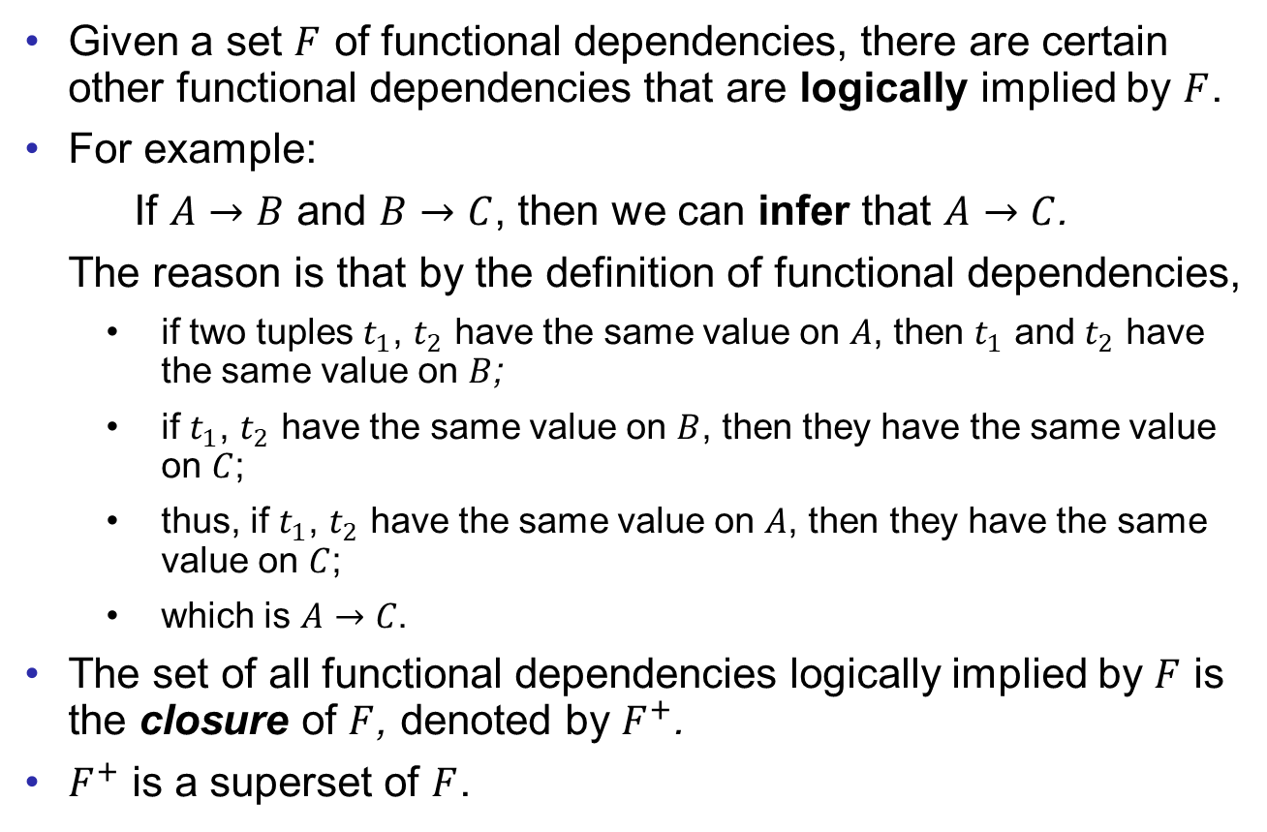
Closure of a Set of Functional Dependencies
Good Design
Atomic
Dependencies
BCNF
3rdNF
MVDs
Design Process
Given a set $F$ of functional dependencies, there are certain other functional dependencies that are logically implied by $F$.
For example:
If $A→B$ and $B→C$, then we can infer that $A→C$.
The reason is that by the definition of functional dependencies,
if two tuples $t_{1}$, $t_{2}$ have the same value on $A$, then $t_{1}$ and $t_{2}$ have the same value on $B$;
if $t_{1}$, $t_{2}$ have the same value on $B$, then they have the same value on $C$;
thus, if $t_{1}$, $t_{2}$ have the same value on $A$, then they have the same value on $C$;
which is $A→C$.
The set of all functional dependencies logically implied by $F$ is the closure of $F$, denoted by $F^{+}$.
$F^{+}$ is a superset of $F$.

Slide 11
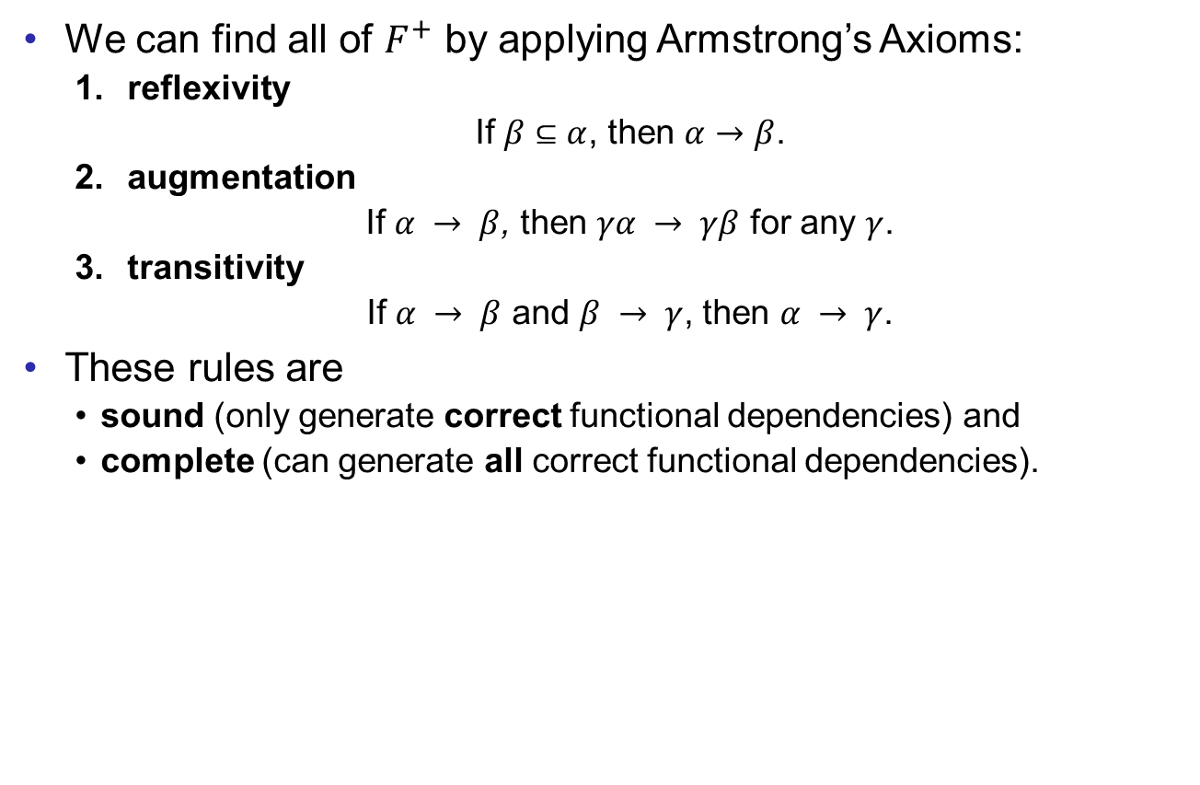
Closure of a Set of Functional Dependencies
Good Design
Atomic
Dependencies
BCNF
3rdNF
MVDs
Design Process
We can find all of $F^{+}$ by applying Armstrong’s Axioms:
reflexivity
If $β⊆α$, then $α→β$.
augmentation
If $α → β$, then $γα → γβ$ for any $γ$.
transitivity
If $α → β$ and $β → γ$, then $α → γ$.
These rules are
sound (only generate correct functional dependencies) and
complete (can generate all correct functional dependencies).

Slide 12
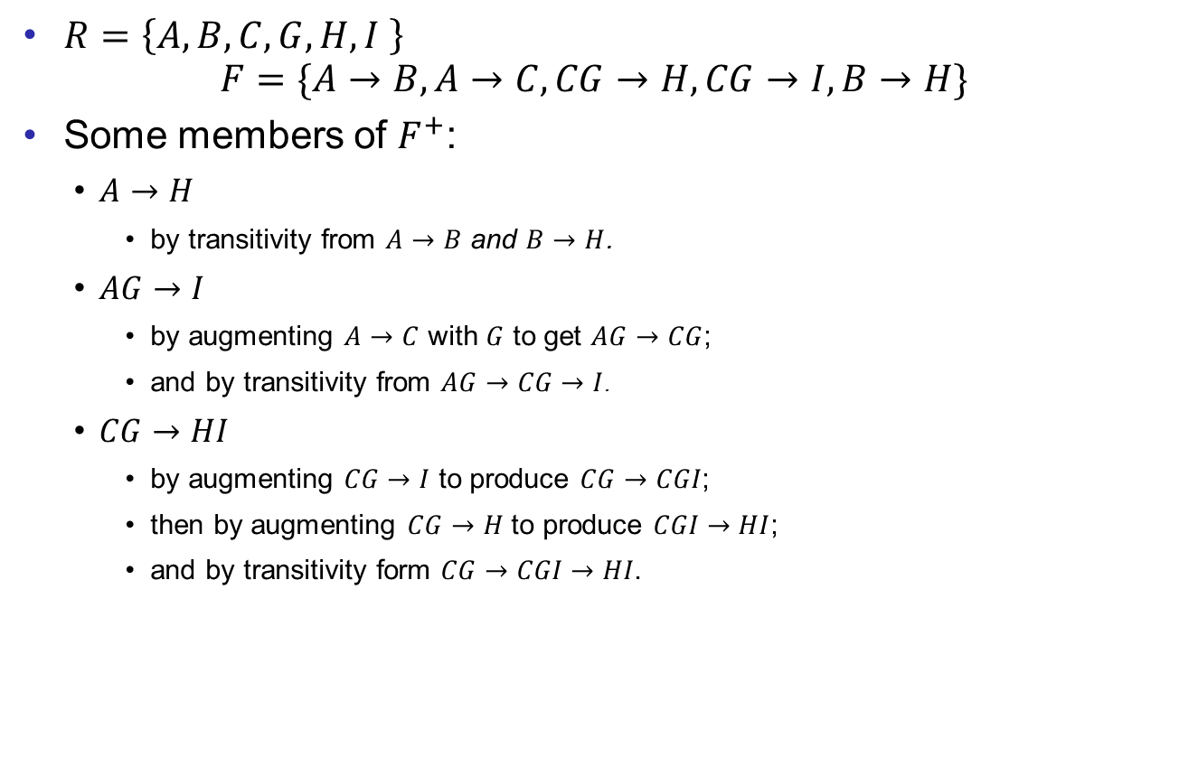
Closure Example
Good Design
Atomic
Dependencies
BCNF
3rdNF
MVDs
Design Process
$R=\left\{A, B, C, G, H, I \right\}$
$$F=\{A→B, A→C, CG→H, CG→I, B→H\}$$
Some members of $F^{+}$:
$A→H$
by transitivity from $A→B$ and $B→H$.
$AG→I$
by augmenting $A→C$ with $G$ to get $AG→CG$;
and by transitivity from $AG→CG→I$.
$CG→HI$
by augmenting $CG→I$ to produce $CG→CGI$;
then by augmenting $CG→H$ to produce $CGI→HI$;
and by transitivity form $CG→CGI→HI$.

Slide 13
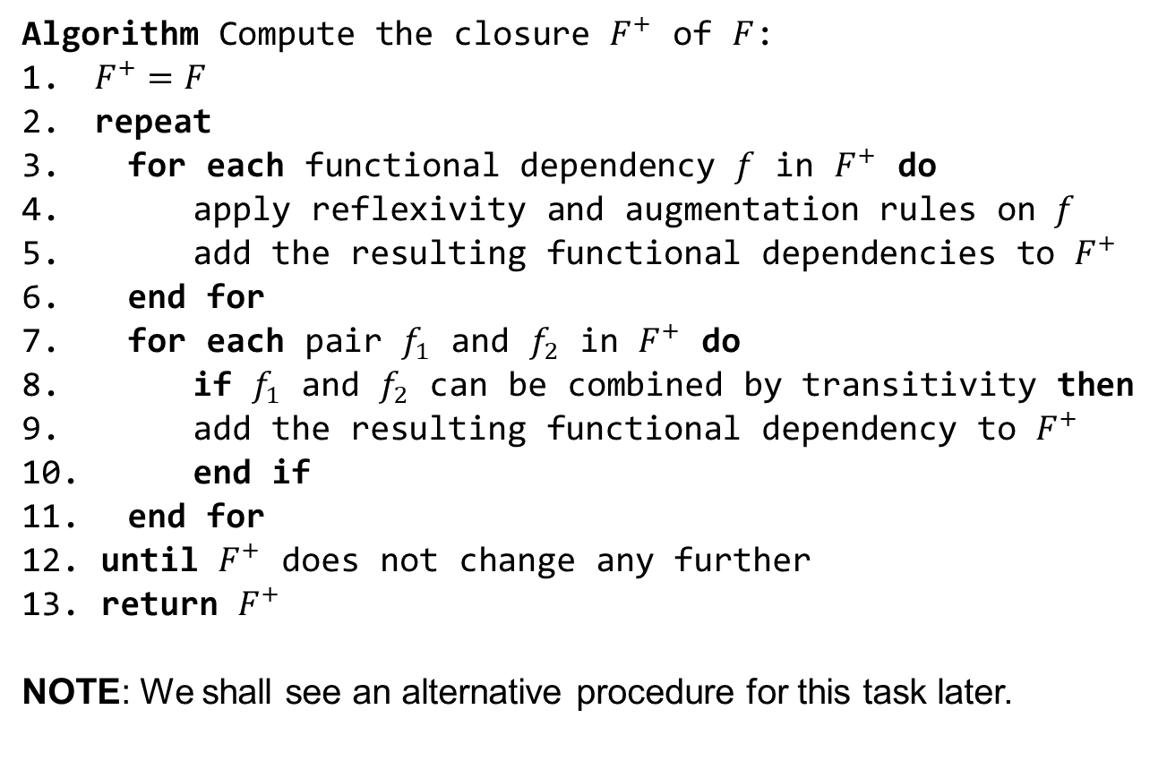

Pseudo Code for Computing $F^{+}$
Good Design
Atomic
Dependencies
BCNF
3rdNF
MVDs
Design Process
Algorithm Compute the closure $F^{+}$ of $F$:
$F^{+}=F$
repeat
for each functional dependency $f$ in $F^{+}$ do
apply reflexivity and augmentation rules on $f$
add the resulting functional dependencies to $F^{+}$
end for
for each pair $f_{1}$ and $f_{2}$ in $F^{+}$ do
if $f_{1}$ and $f_{2}$ can be combined by transitivity then
add the resulting functional dependency to $F^{+}$
end if
end for
until $F^{+}$ does not change any further
return $F^{+}$
NOTE: We shall see an alternative procedure for this task later.

Slide 14
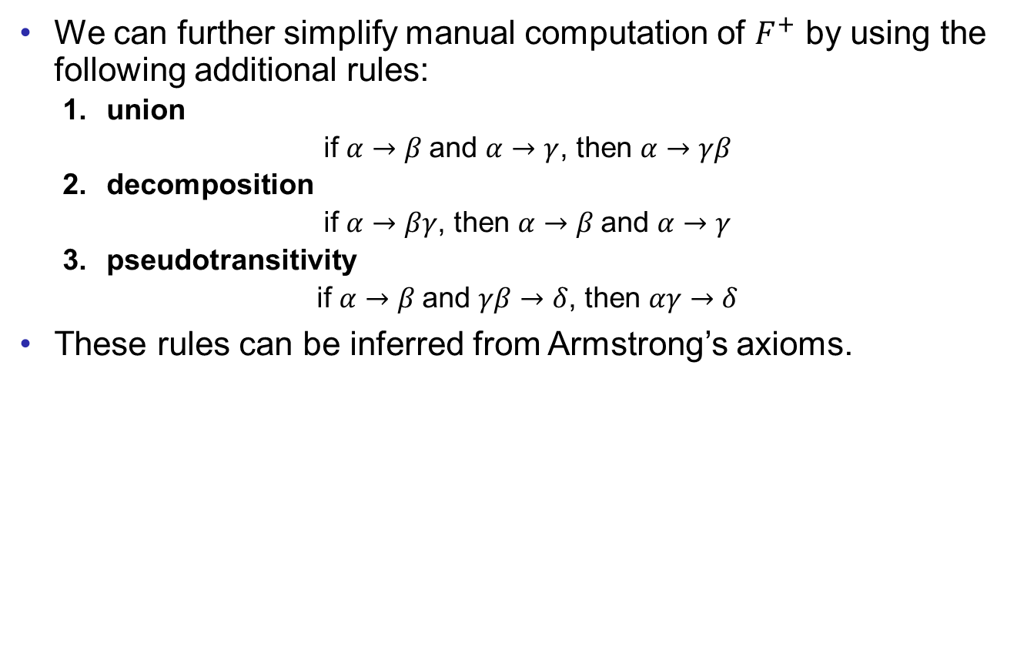
Closure of Functional Dependencies (Cont.)
Good Design
Atomic
Dependencies
BCNF
3rdNF
MVDs
Design Process
We can further simplify manual computation of $F^{+}$ by using the following additional rules:
union
if $α→β$and $α→γ$, then $α→γβ$
decomposition
if $α→βγ$, then $α→β$and $α→γ$
pseudotransitivity
if $α→β$and $γβ→δ$, then $αγ→δ$
These rules can be inferred from Armstrong’s axioms.

Slide 15
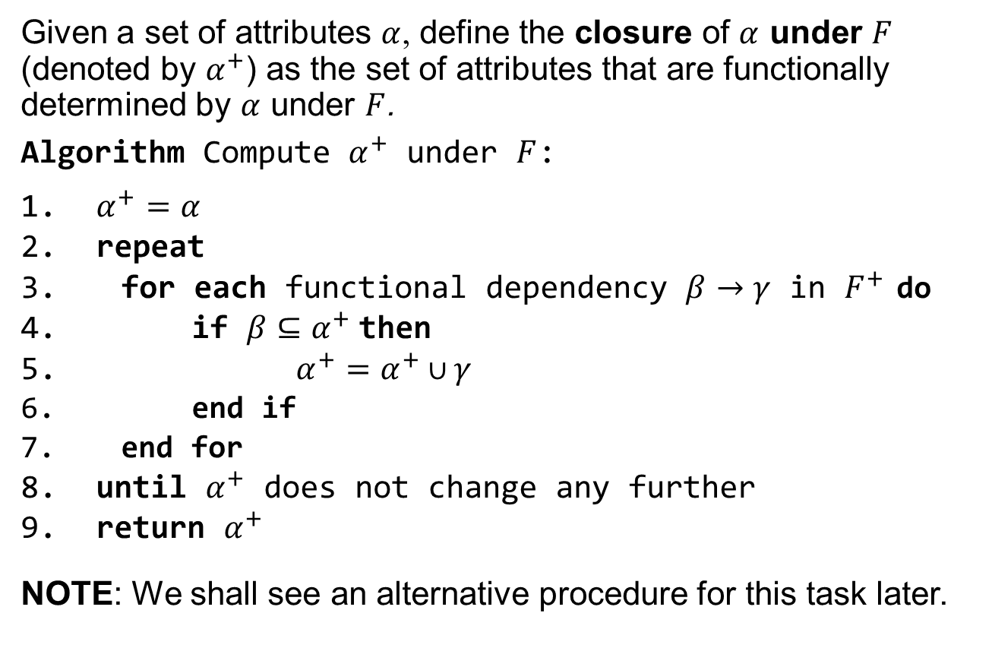
Closure of Attribute Sets
Good Design
Atomic
Dependencies
BCNF
3rdNF
MVDs
Design Process
Given a set of attributes $α$, define the closure of $α$ under $F$ (denoted by $α^{+}$) as the set of attributes that are functionally determined by $α$ under $F$.
Algorithm Compute $α^{+}$ under $F$:
$α^{+}=α$
repeat
for each functional dependency $β→γ$ in $F^{+}$ do
if $β⊆α^{+}$then
$α^{+}=α^{+}∪γ$
end if
end for
until $α^{+}$ does not change any further
return $α^{+}$
NOTE: We shall see an alternative procedure for this task later.

Slide 16
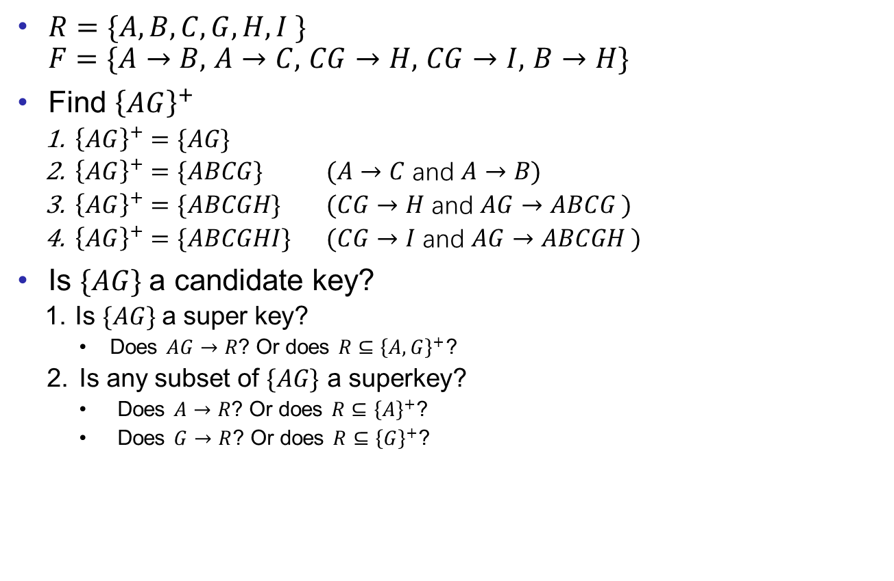
Example of Attribute Set Closure
Good Design
Atomic
Dependencies
BCNF
3rdNF
MVDs
Design Process
$R=\{A, B, C, G, H, I \}$ $F=\{A→B,$ $A→C,$ $CG→H,$ $CG→I,$ $B→H\}$
Find ${\left\{AG\right\}}^{+}$
${\left\{AG\right\}}^{+}=\{AG\}$
${\left\{AG\right\}}^{+}=\{ABCG\}$ $(A→C$ and $A→B)$
${\left\{AG\right\}}^{+}=\{ABCGH\}$ $(CG→H$ and $AG→ABCG )$
${\left\{AG\right\}}^{+}=\{ABCGHI\}$ $(CG→I$ and $AG→ABCGH )$
Is $\{AG\}$a candidate key?
Is $\{AG\}$a super key?
Does $AG→R$? Or does $R⊆{\left\{A,G\right\}}^{+}$?
Is any subset of $\{AG\}$ a superkey?
Does $A→R$? Or does $R⊆{\left\{A\right\}}^{+}$?
Does $G→R$? Or does $R⊆{\left\{G\right\}}^{+}$?

Slide 17
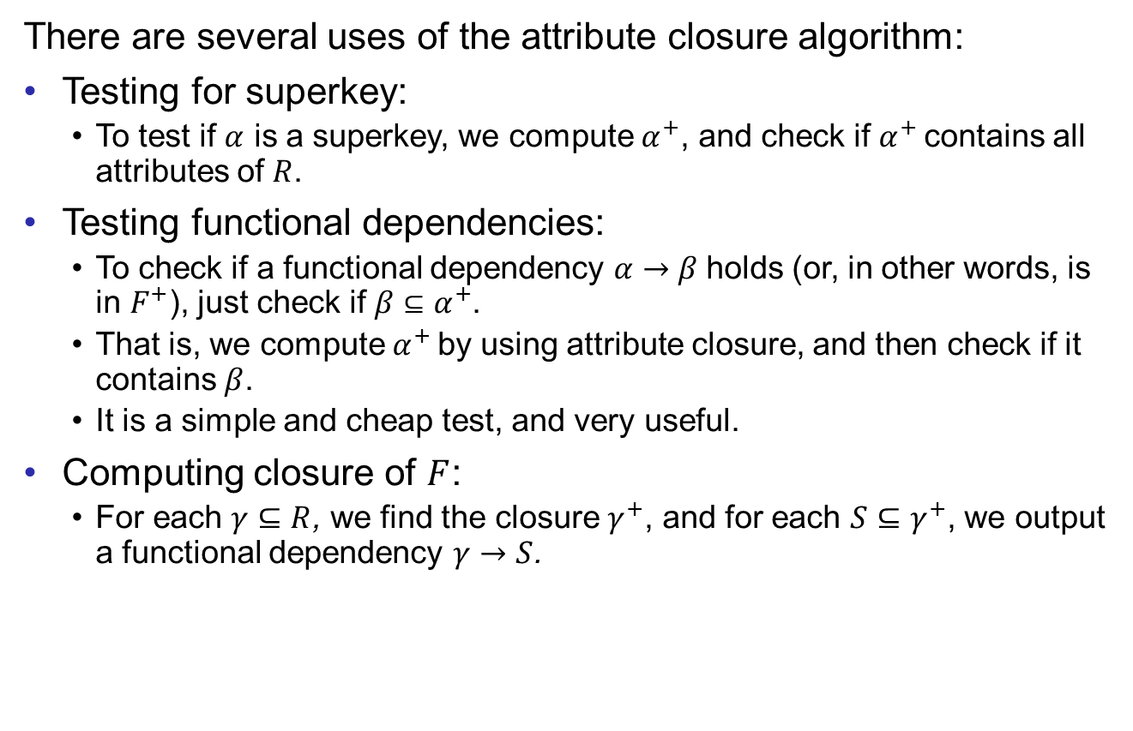
Uses of Attribute Closure
Good Design
Atomic
Dependencies
BCNF
3rdNF
MVDs
Design Process
There are several uses of the attribute closure algorithm:
Testing for superkey:
To test if $α$ is a superkey, we compute $α^{+}$, and check if $α^{+}$ contains all attributes of $R$.
Testing functional dependencies:
To check if a functional dependency $α→β$holds (or, in other words, is in $F^{+}$), just check if $β⊆α^{+}$.
That is, we compute $α^{+}$ by using attribute closure, and then check if it contains $β$.
It is a simple and cheap test, and very useful.
Computing closure of $F$:
For each $γ⊆R$, we find the closure $γ^{+}$, and for each $S⊆γ^{+}$, we output a functional dependency $γ→S$.

Slide 18

Example
Good Design
Atomic
Dependencies
BCNF
3rdNF
MVDs
Design Process
Let $R=\{A,B,C,D,E,F\}$ and
$F=\{AB→C,AD→E,B→D,AF→B\}$
Compute ${\left\{A,B\right\}}^{+}$ and ${\left\{A,F\right\}}^{+}$

Slide 19
End of Lecture 9
Good Design
Atomic
Dependencies
BCNF
3rdNF
MVDs
Design Process

